Slide 1

Learning Words by Drawing Images
D´ıdac Sur´ıs, Adria Recasens, David Bau, David Harwath, James Glass, Antonio Torralba
Elif Çalışkan 2016400183

Slide 2
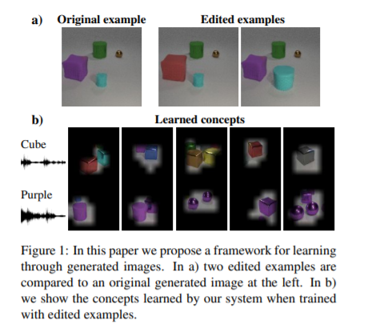
Introduction
Goal is to learn the correspondence between spoken words and abstract visual attributes, from a dataset of spoken descriptions of images.

Slide 3

GAN
A generative adversarial network (GAN) is a class of machine learning systems. Two neural networks contest with each other in a game (in the sense of game theory, often but not always in the form of a zero sum game). Given a training set, this technique learns to generate new data with the same statistics as the training set.
The main focus for GAN (Generative Adversarial Networks) is to generate data from scratch, mostly images but other domains including music have been done. But the scope of application is far bigger than this. Just like the example below, it generates a zebra from a horse. In reinforcement learning, it helps a robot to learn much faster.

Slide 4
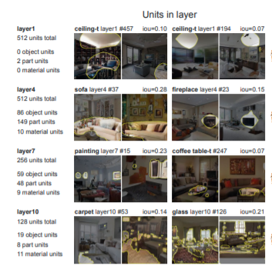
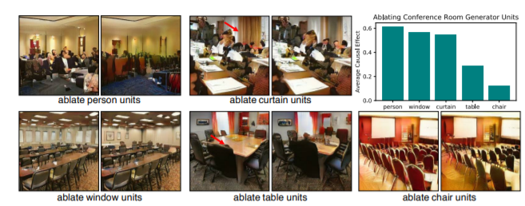
GAN
Furthermore, it has recently been found that GANs can add, remove, and modify objects in a scene by intervening in their internal representations directly
GAN DISSECTION: VISUALIZING AND UNDERSTANDING GENERATIVE ADVERSARIAL NETWORKS

Slide 5
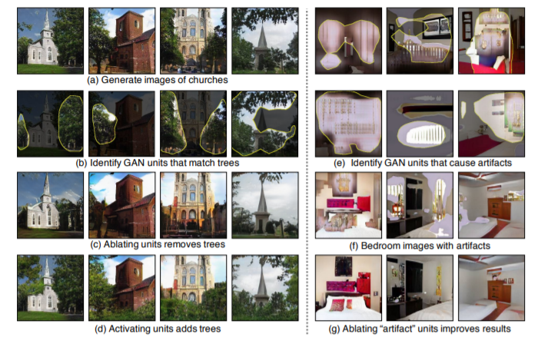
Introduction
Building upon recent ﬁndings that GAN representations can be manipulated to edit semantic concepts in the generated output, they propose a new method to use such GAN-generated images to train a model using a triplet loss.
GAN DISSECTION: VISUALIZING AND UNDERSTANDING GENERATIVE ADVERSARIAL NETWORKS

Slide 6
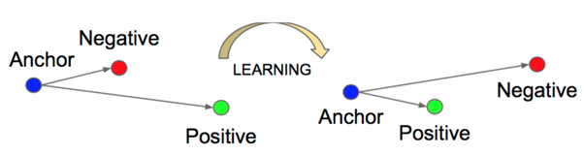
Triplet Loss
It tries to bring close the Anchor (current record) with the Positive (A record that is in theory similar with the Anchor) as far as possible from the Negative (A record that is different from the Anchor).

Slide 7
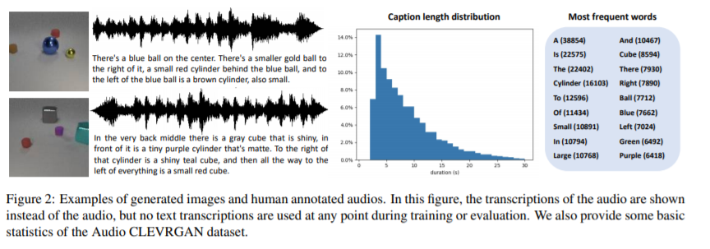
Images and descriptions

Slide 8
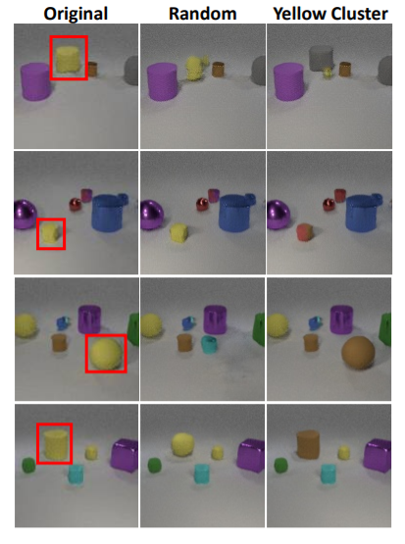
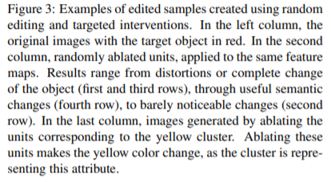
Editing training examples

Slide 9
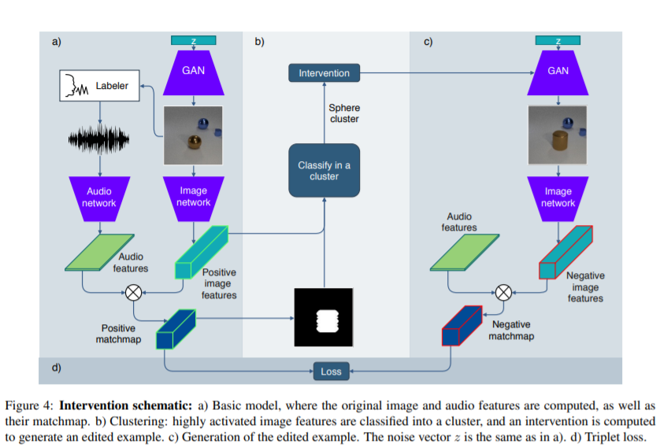
Learning words by drawing images

Slide 10
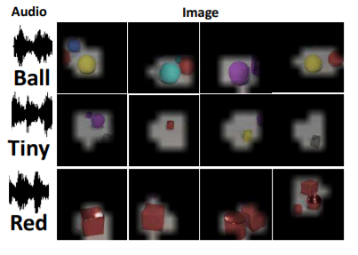
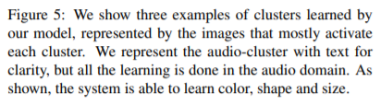
Clustering

Slide 11
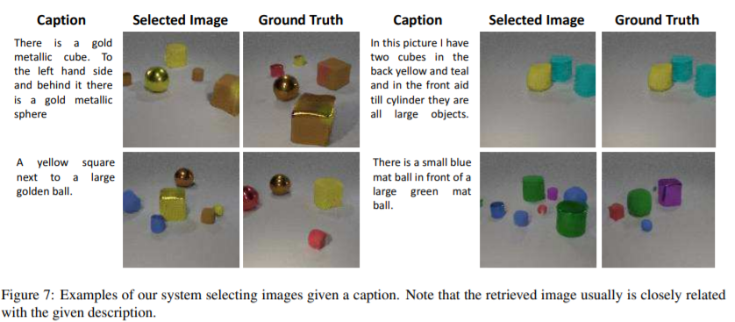
Examples

Slide 12
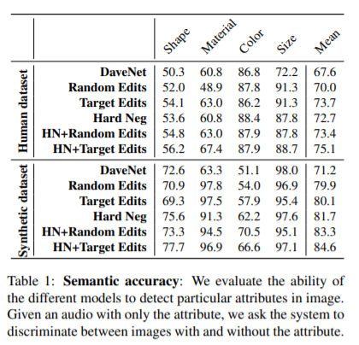
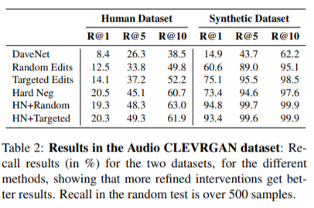
Evaluation

Slide 13
Thank you for listening!

